Slide 1


Analysis of Astrometry in the JWST North Ecliptic Pole (NEP) Time Domain Field (TDF)
Victoria Jones
Dr. Rolf Jansen

Slide 2
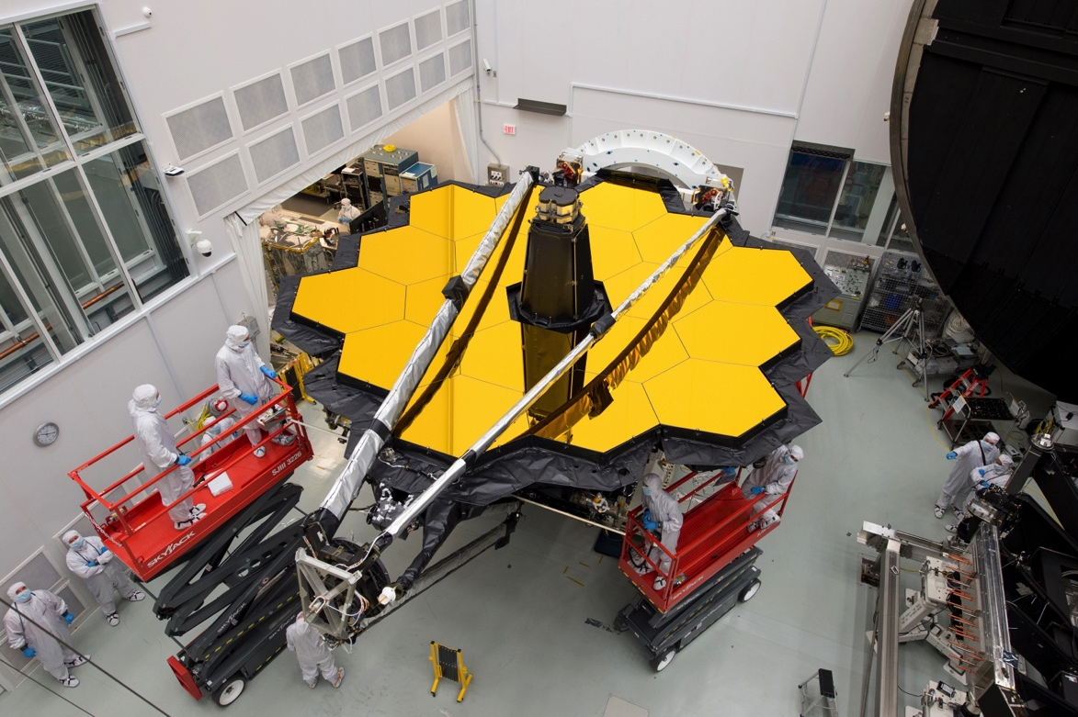
JWST NEP TDF
Located within JWST’s northern Continuous Viewing Zone centered on the NEP
Void of bright foreground stars and low galactic foreground extinction
Community field for time domain science
Image Credit: Desiree Stover/NASA

Slide 3
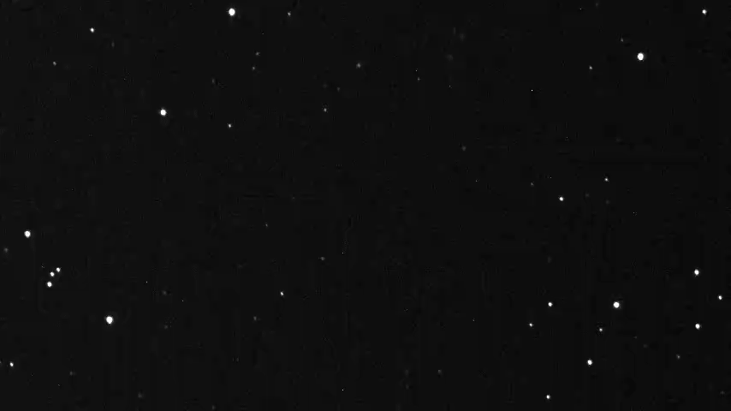
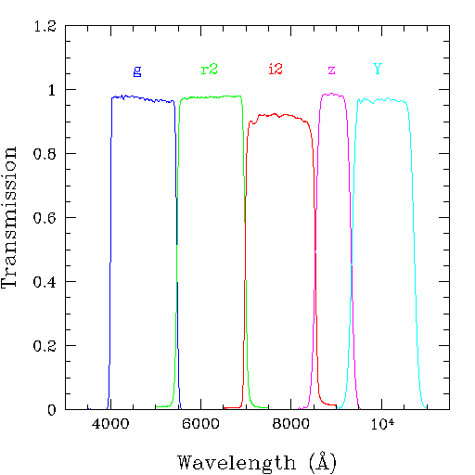
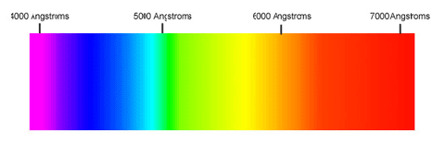
Background
What is astrometry?
Filter Profiles
Image Credit: Kiso Observatory, University of Tokyo
Image Credit: (Top) NAOJ (Bottom) livephysics

Slide 4
Project Outline
Create artificial images of Subaru data
Match the Subaru and LBT catalogs by Right Ascension and Declination
Astrometrically cross-register the Subaru and LBT images with milli-arcsec precision and identify moving objects (comets, galactic stars, brown dwarfs)

Slide 5
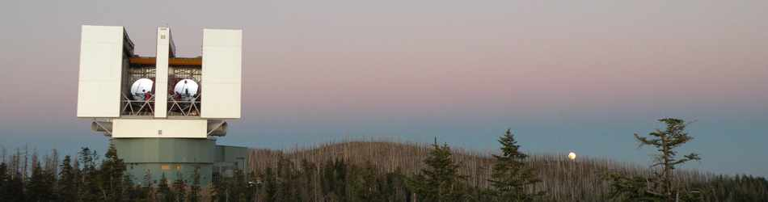
Large Binocular Telescope Data
Large Binocular Camera Filters (U, g, r, z)
Observed July 2016 for half a night
Equivalent to full night on 8.4 m telescope
Median seeing ~ 0.95” with depth ~ 26 AB magnitude
Observations part of the field selection
Image Credit: Large Binocular Telescope Observatory Website

Slide 6
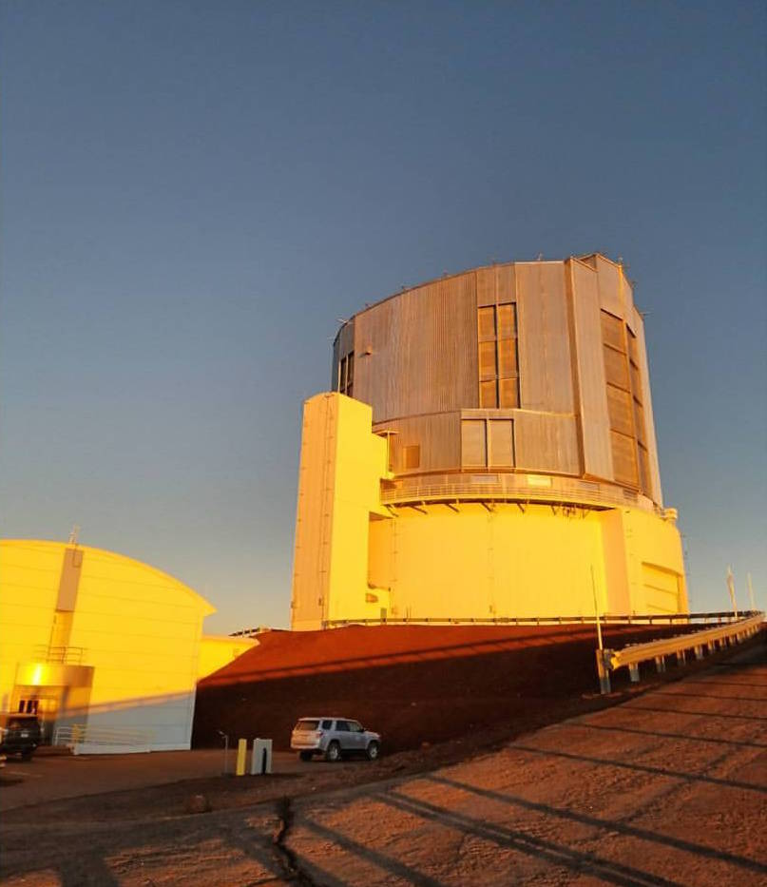
Subaru Observations and Data
Hyper Suprime-Cam Filters (g, i, z, NB816, NB921)
Observed June 2017 over five nights
Seeing between ~ 0.5” and 1.0” with depth ~ 24-26 AB magnitude
Observations part of larger HEROES survey
Almost 1 year after LBT data
Image Credit: Cameron White

Slide 7
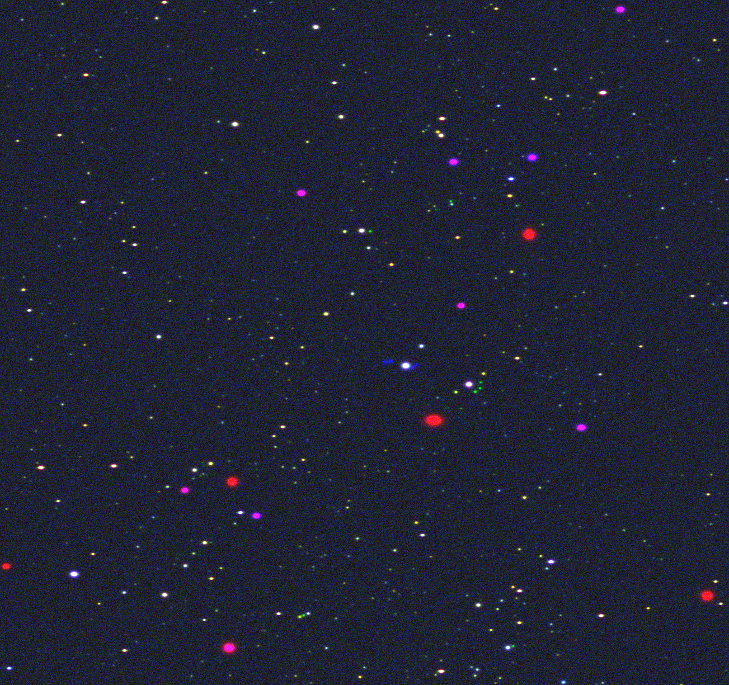
Results: Artificial Images
Aid in the visual validation of moving objects
Red and magenta objects correspond to bright sources that saturated the relatively long Subaru exposures in both g and i2, and just g, respectively
HSC-g
HSC-i
HSC-z
HSC-g
HSC-i2
HSC-z

Slide 8
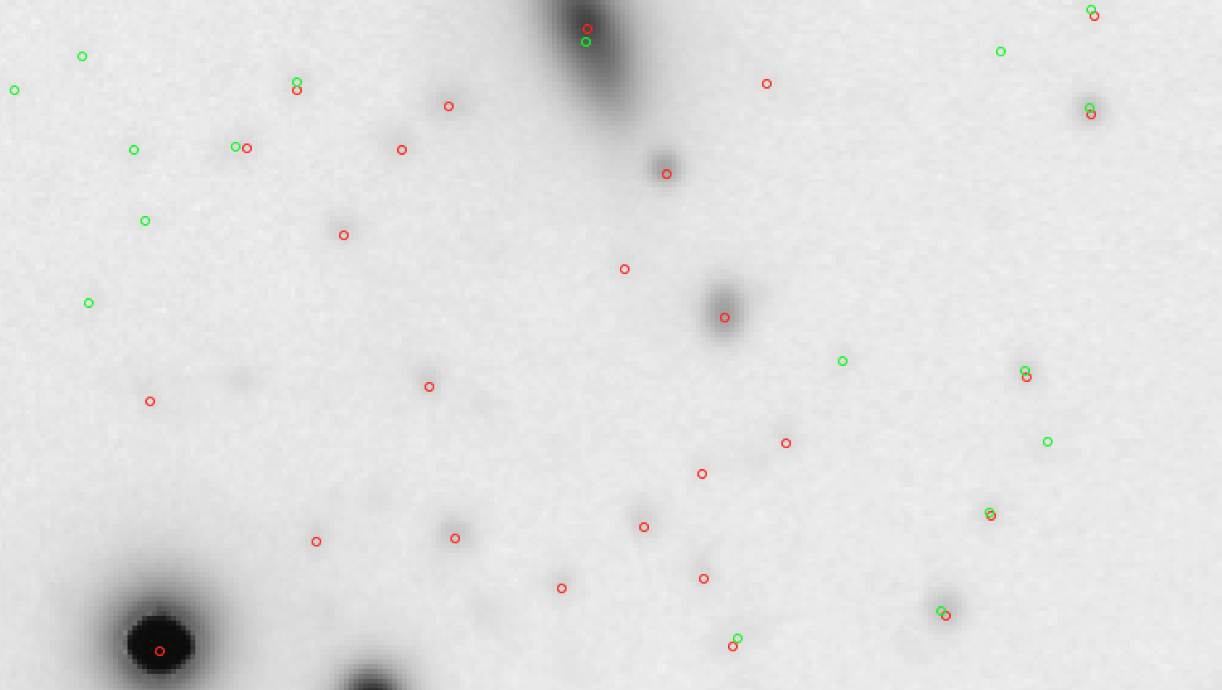
Results: LBT Astrometry
LBT: four separate chips in each camera
Must mosaic the images together to get the full picture

Slide 9
Future Work
Improve the LBT astrometry
Identify objects that move significantly with respect to instrumental resolution
Repeat this analysis with the photometry
Incorporate data taken by Hubble Space Telescope
Better resolution than either LBT or Subaru
Publish paper in Astrophysical Journal

Slide 10





Acknowledgments
Collaborators: Rogier Windhorst, Seth Cohen, Teresa Ashcraft, & NEP TDF team
Guenther Hasinger, Esther Hu, Christopher Waters and the HEROES team at the Institute for Astronomy at University of Hawaii
ASU/NASA Space Grant Consortium

